Slide 1
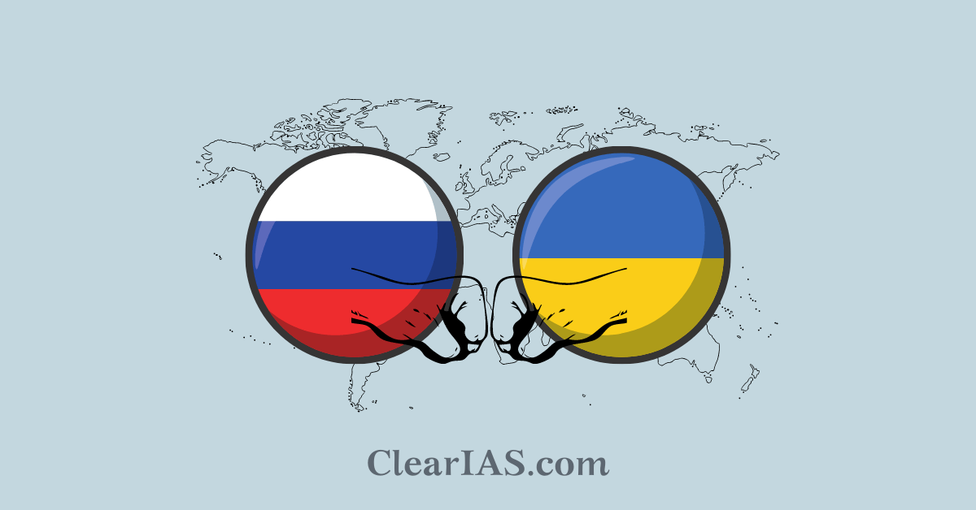
Russia Ukraine War
Twitter Sentiment Analysis

Slide 2

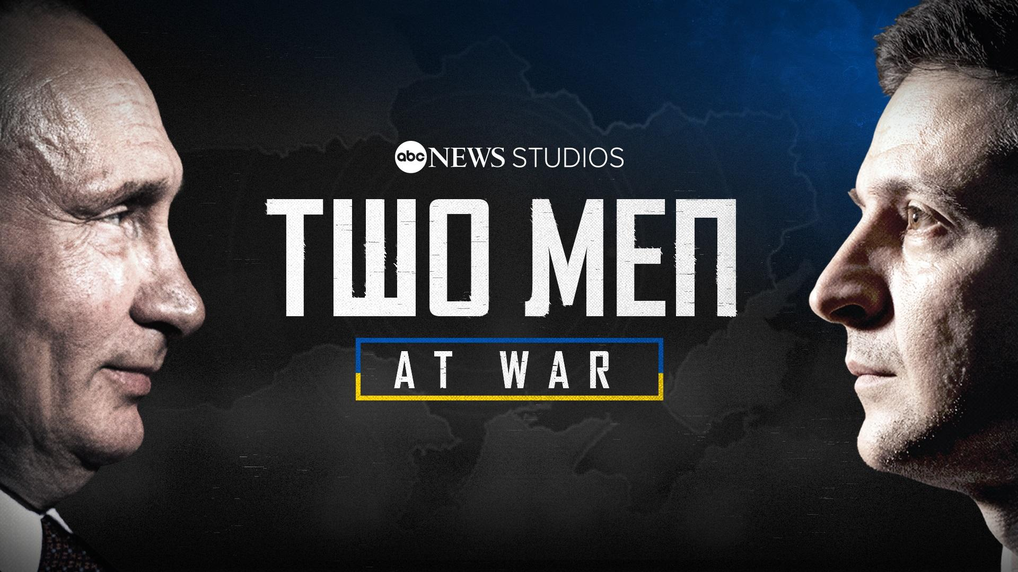
VLADIMIR PUTIN
VOLODYMYR ZELENSKY

Slide 3
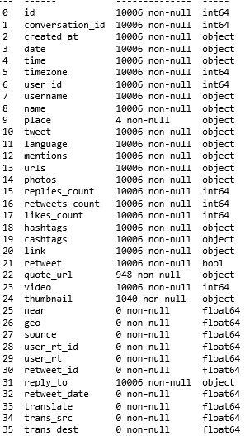
DATASET FEATURES

Slide 4
DATA CLEANING
1
2
3
Removing Null
Removing Spaces
Removing links, brackets, numbers and punctuations.
Handling Emojis
Handling Stopwords
Contraction
Stemming
Lemmatization
Tokenization

Slide 5
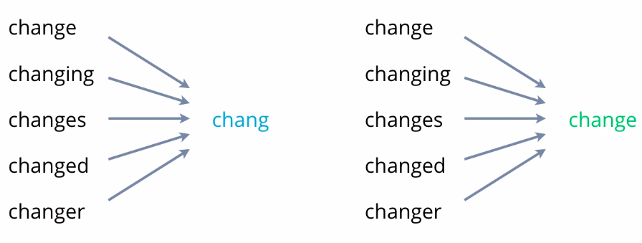

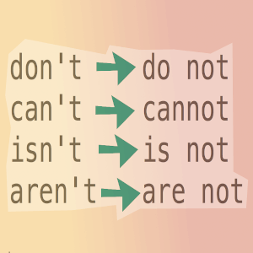
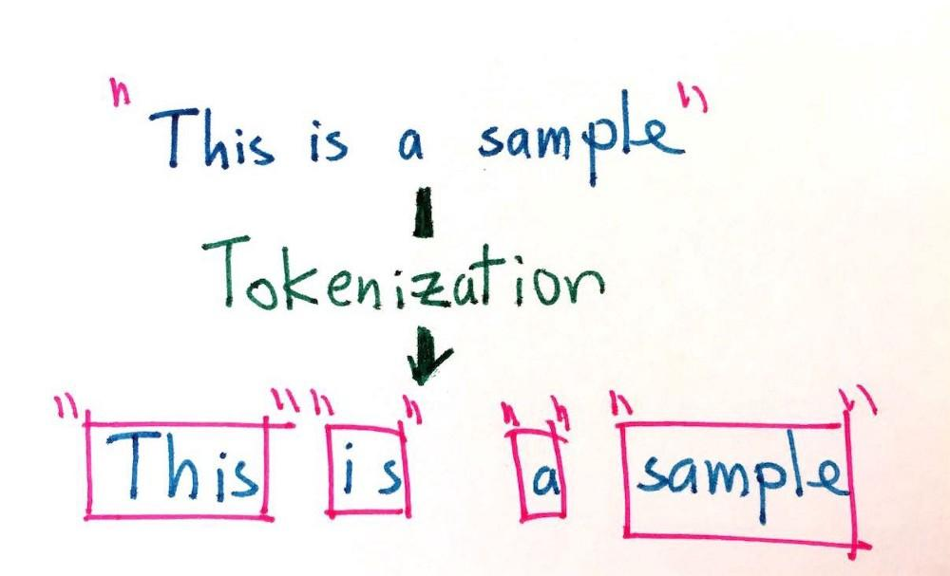
STEMMING AND LEMMETIZATION
CONTRACTION
TOKENIZATION

Slide 6
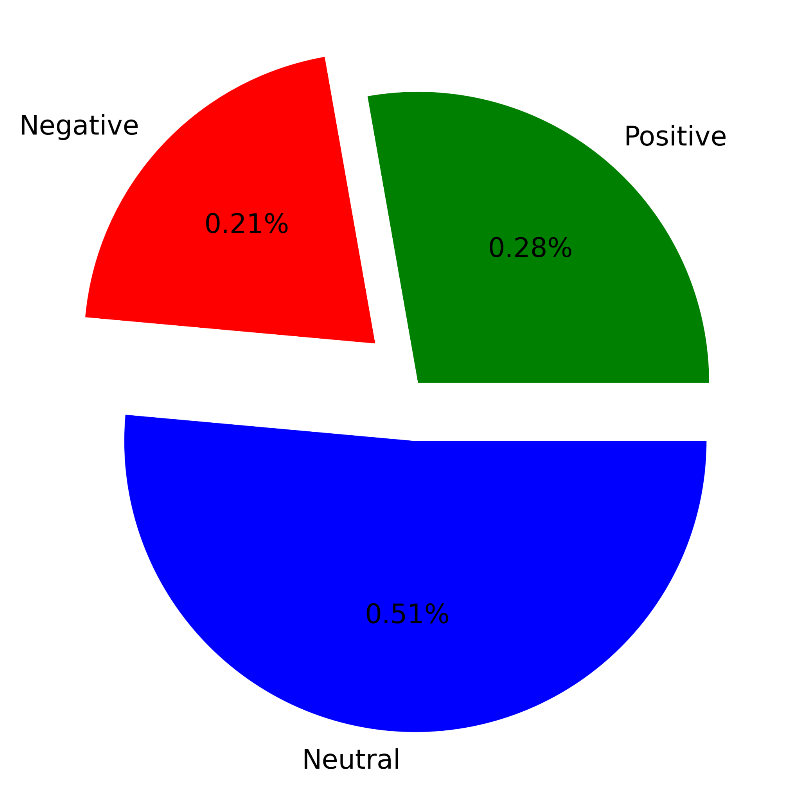
POLARITY ANALYSIS
Polarity > 0 : Positive
Polarity = 0 : Neutral
Polarity < 0 : Negative

Slide 7
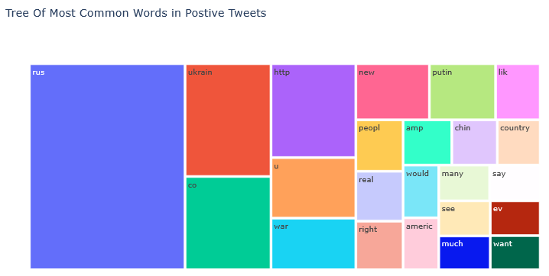

Slide 8
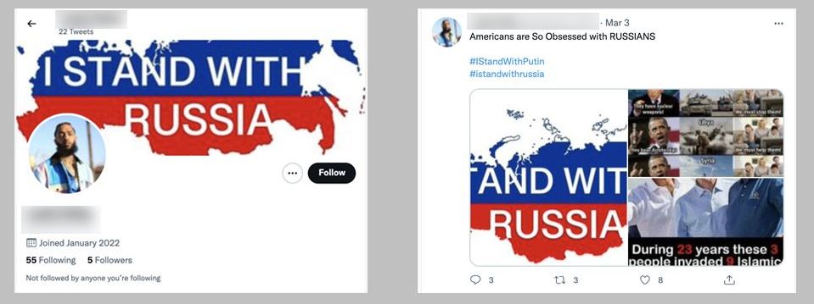
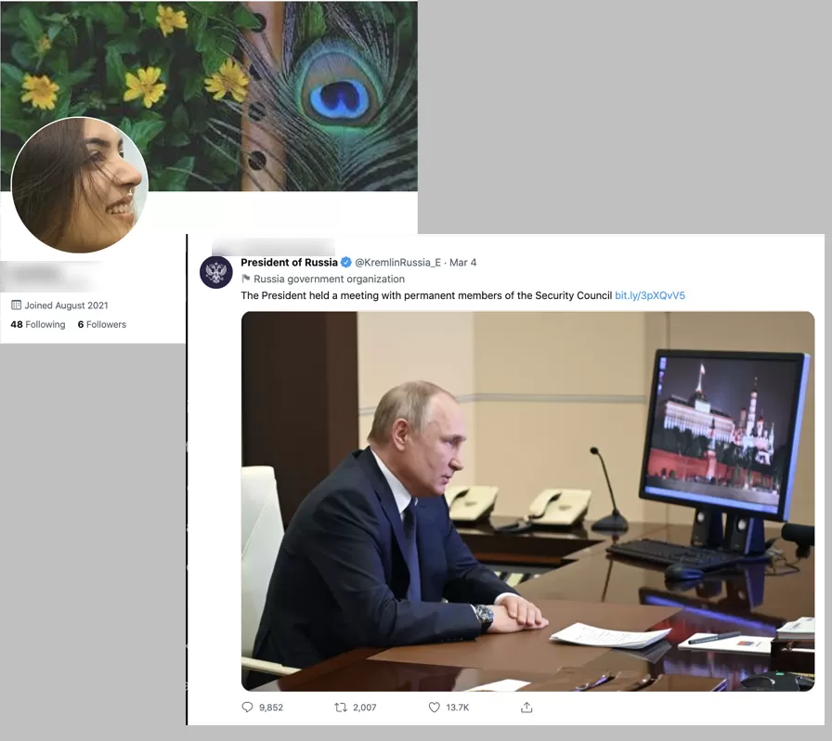
Identity Fraud
Bots
Focused Areas:
India
Pakistan
South Africa
Nigeria

Slide 9
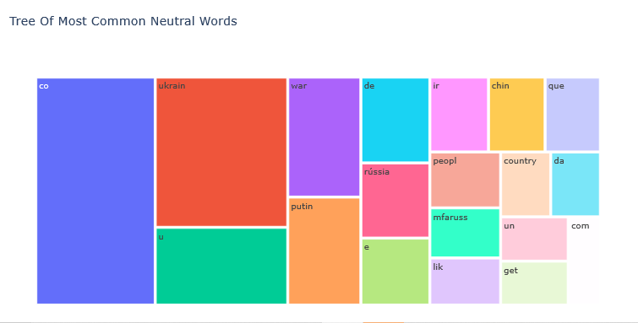

Slide 10
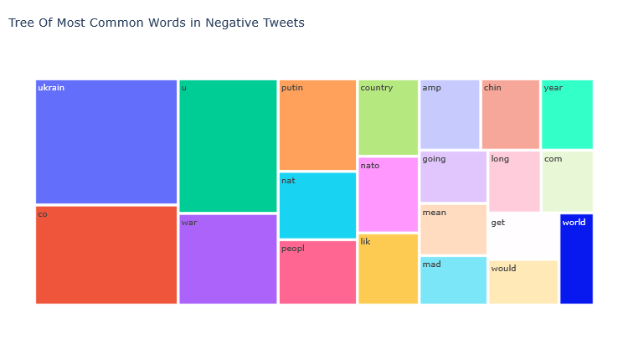

Slide 11
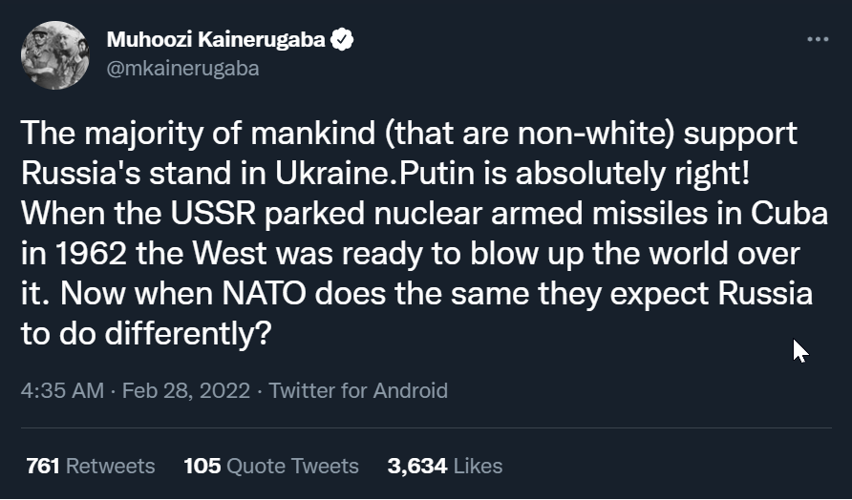
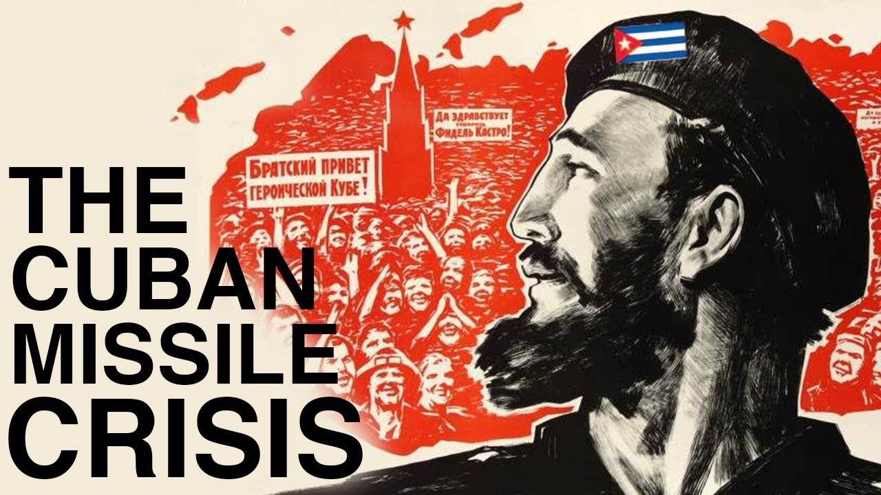

Slide 12
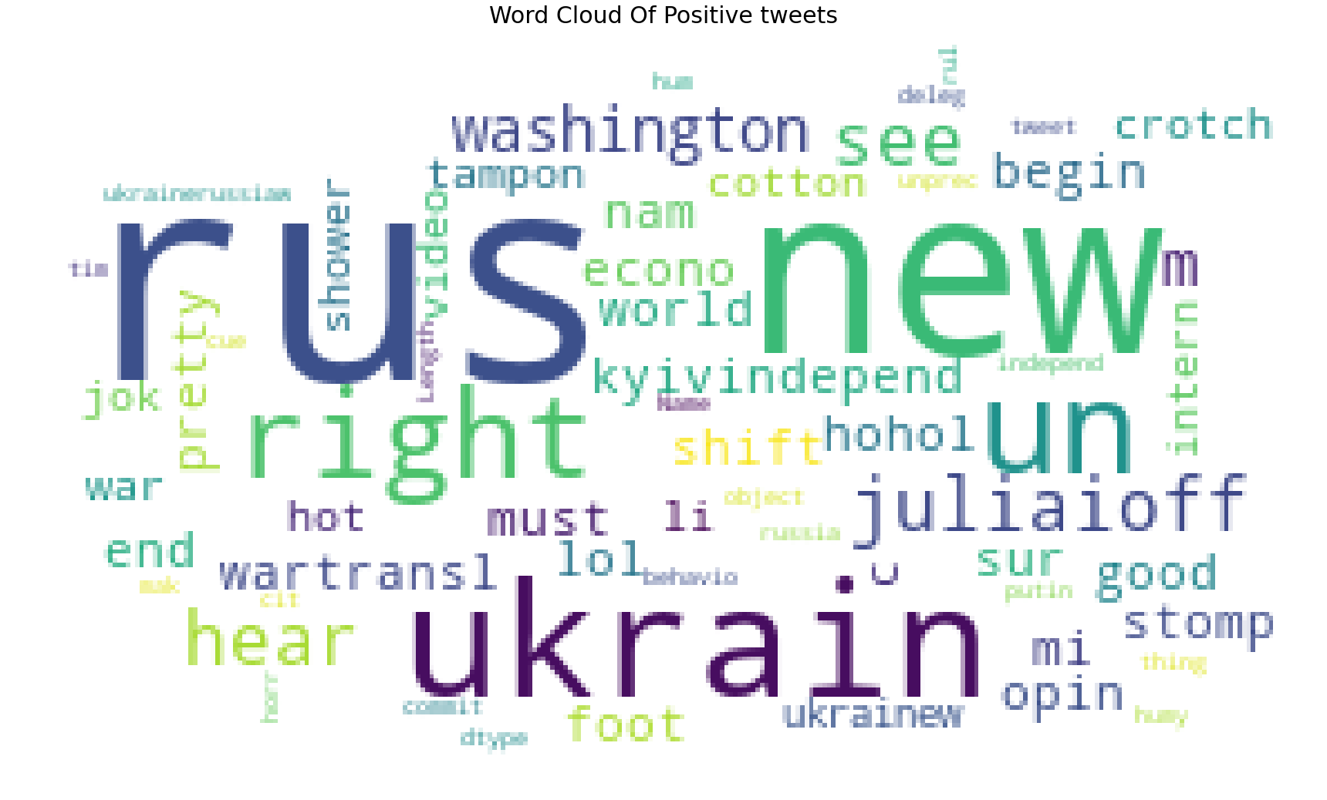

Slide 13
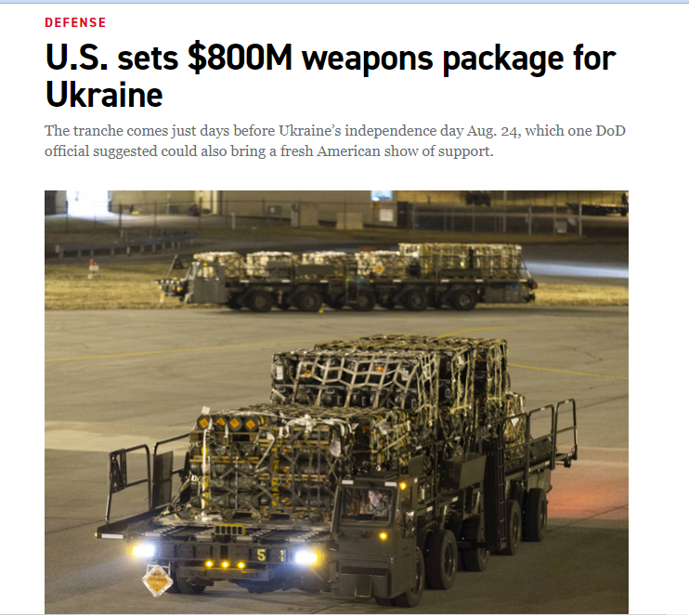
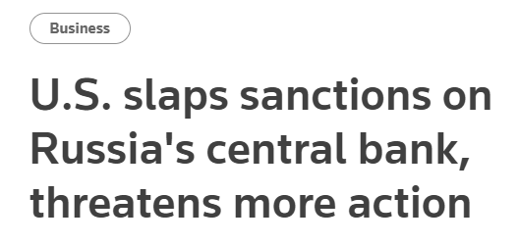


ROLE OF WASHINGTON (US)

Slide 14
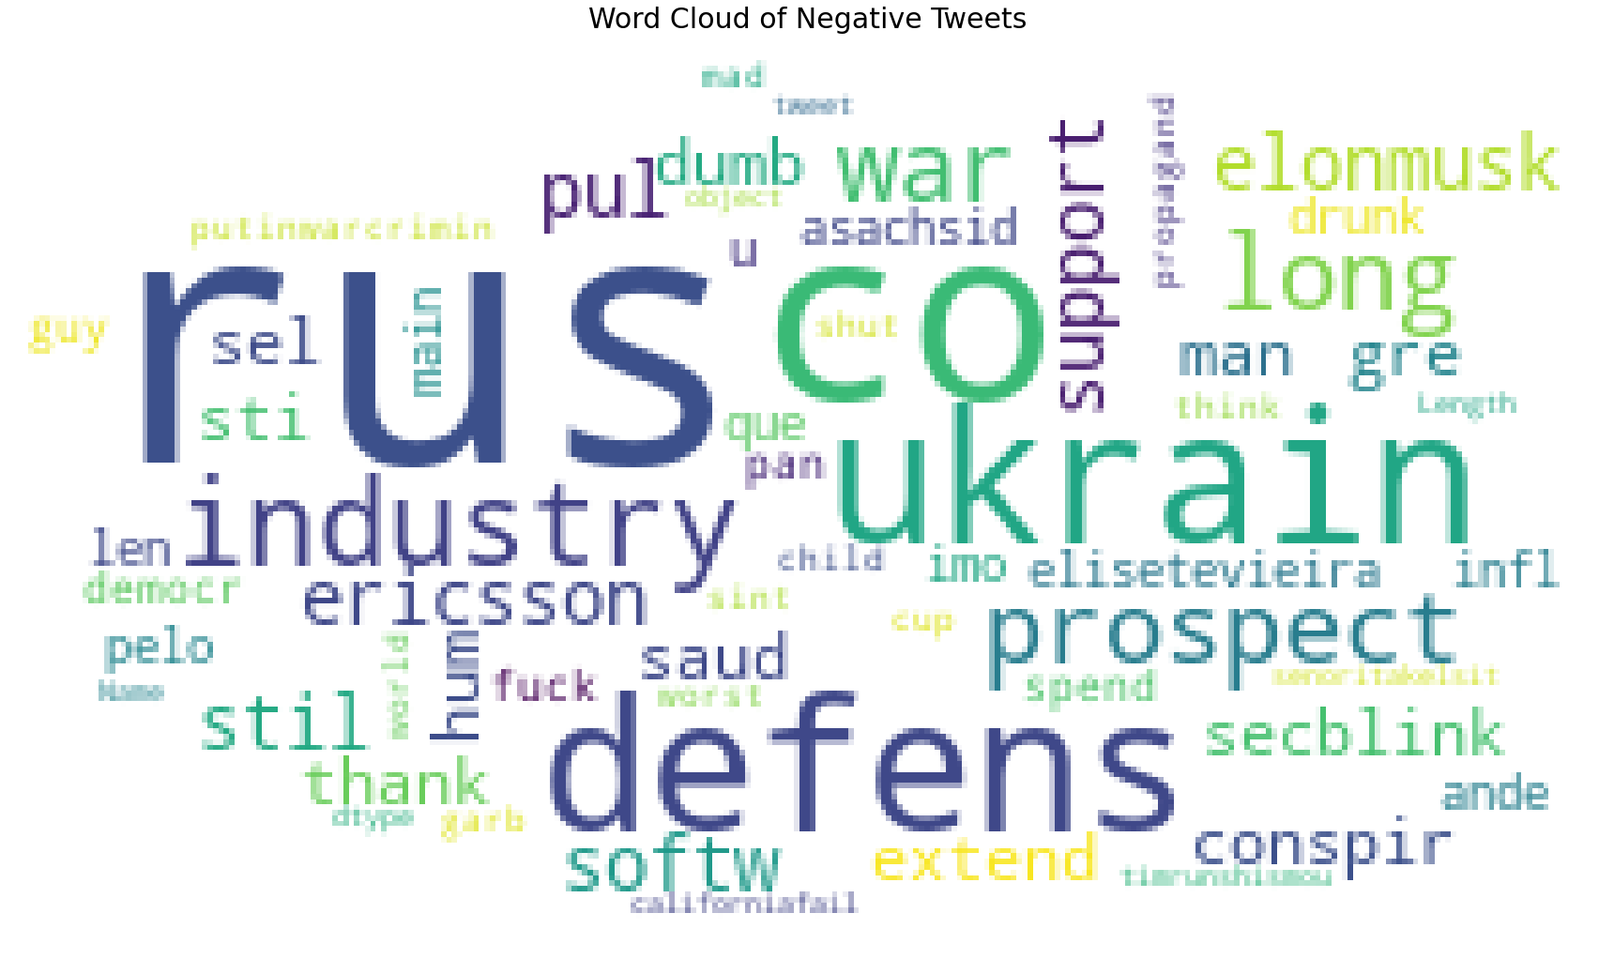

Slide 15
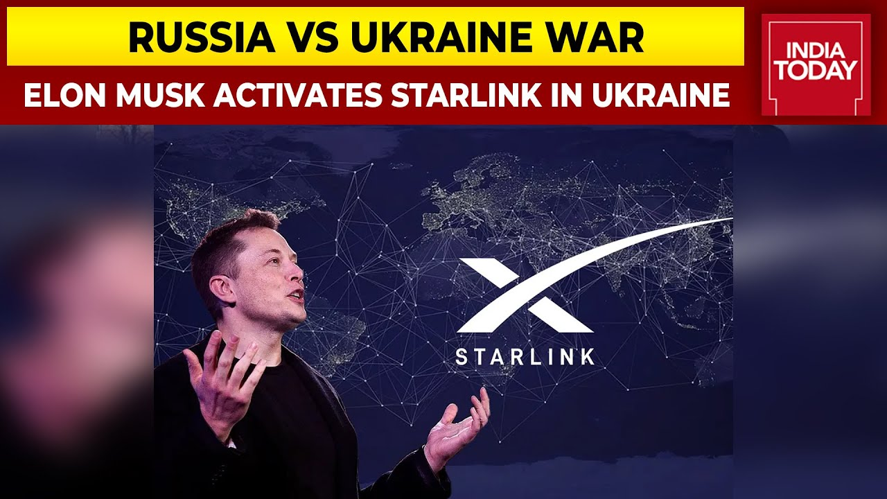

Slide 16
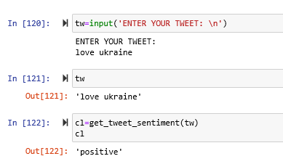
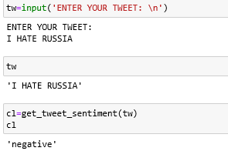

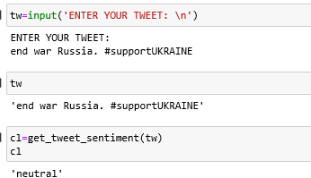
POLARITY RESULTS

Slide 17
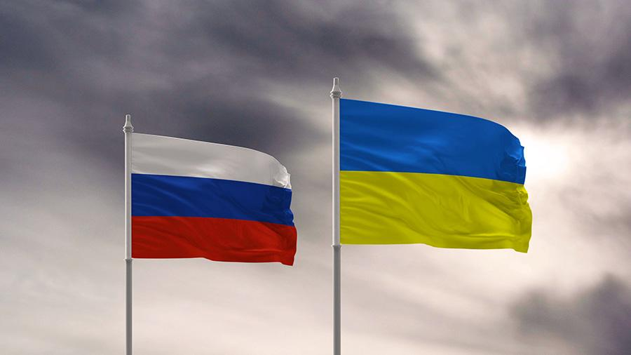
CONCLUSION
Fake tweets by Russia
USSR & Cuba Similarity detected
Role of US
Elon Musk - Starlink

Slide 18

THANK YOU

